Slide 1
GESIS Methods Hub
Chung-hong Chan, Fakhri Momeni, Taimoor Khan and Flix Münch
methodsNET 12.09.2025

Slide 2
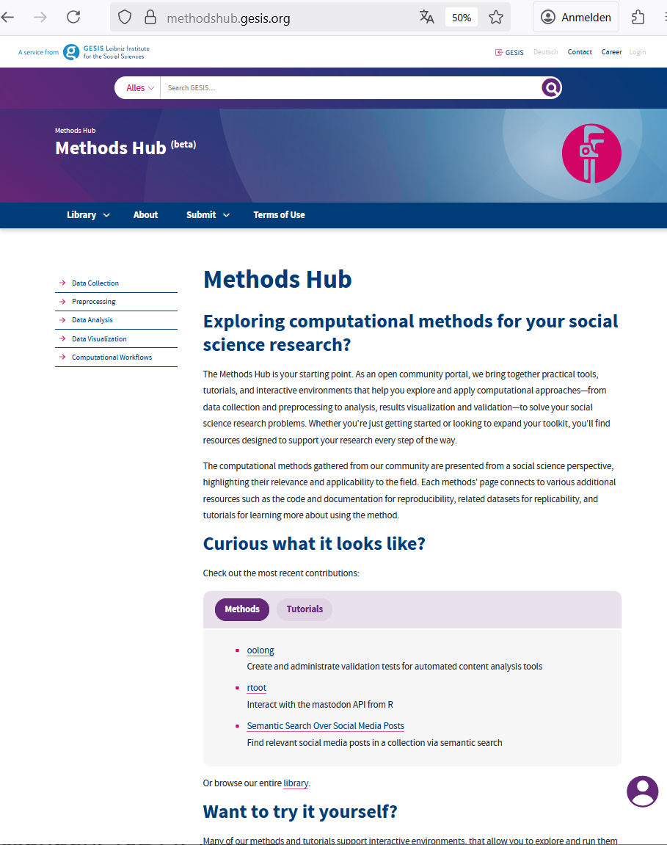
Methods Hub
A GESIS initiative for discoverable reusable and reproducible research methods

Slide 3
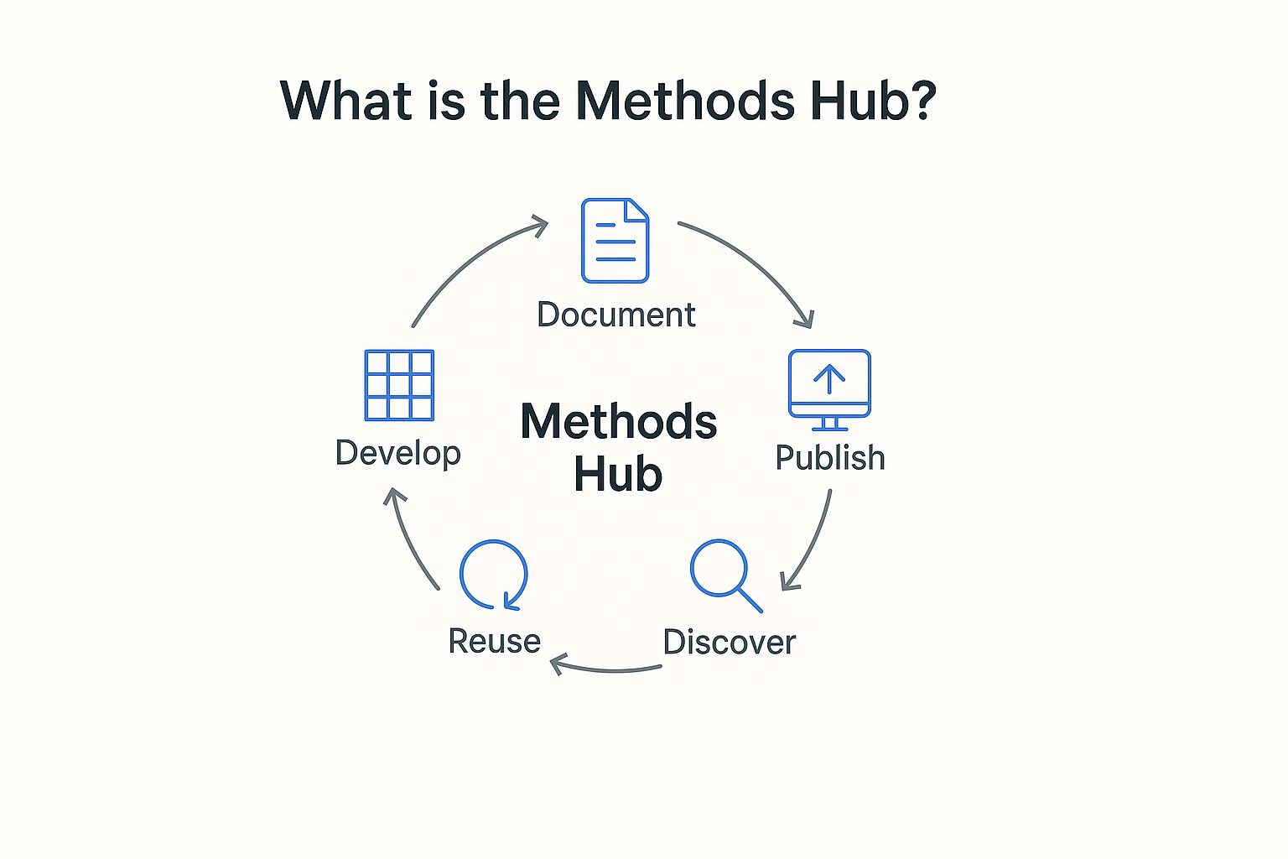
Document
Develop
Publish
Reuse
Discover

Slide 4

For Method Users
Search and
Explore
what it does, who built it, which use cases it fits
Apply in Practice
Get clear guidance on implementation
Cite properly
Guidance on citation
Learn from Tutorials
Step-by-step guides to reproduce or adapt the method

Slide 5

Reuse with Confidence
Link to the publications
See the research paper that use or describe the method
Contributor Attribution
Know who developed or contributed to it
Contextual Unterstanding
Understand how the methods fits in the research ecosystem

Slide 6
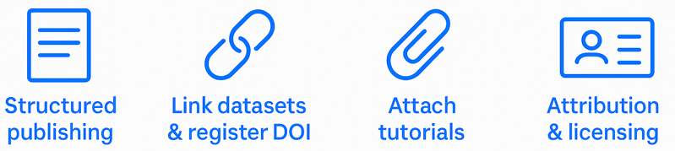



For Method Developers: Share, Cite, Reuse
Less support, more innovation
Trusted through metadata & documentation
Easier to reuse and cite
Make your methods discoverable, reproducible, and reusable by design.

Slide 7
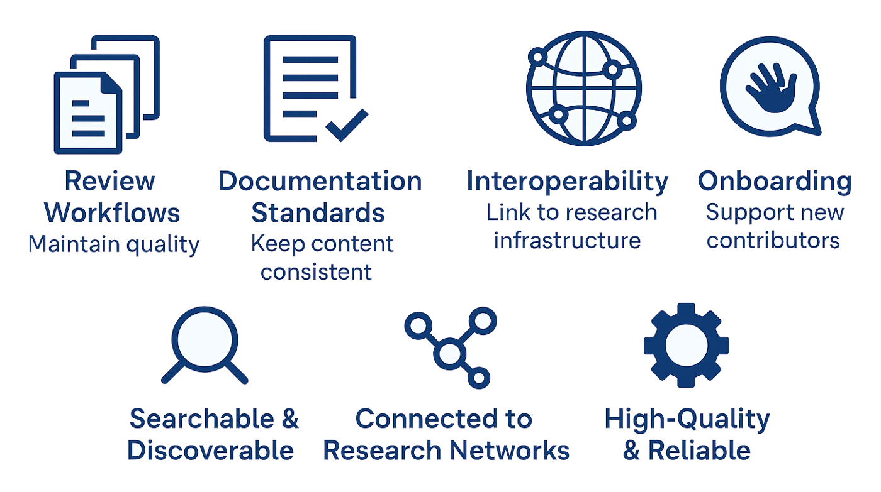
Behind the Scenes: Curation & Support

Slide 8
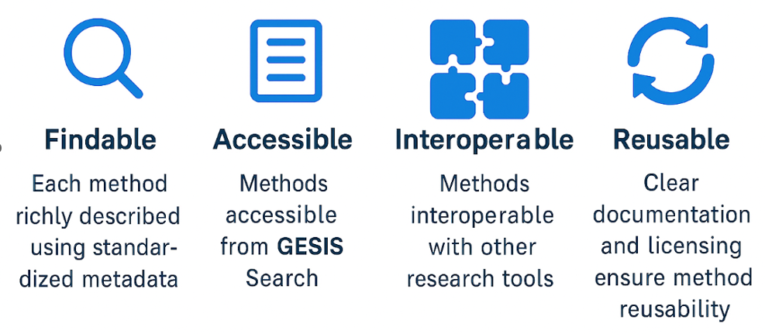
FAIR by Design

Slide 9
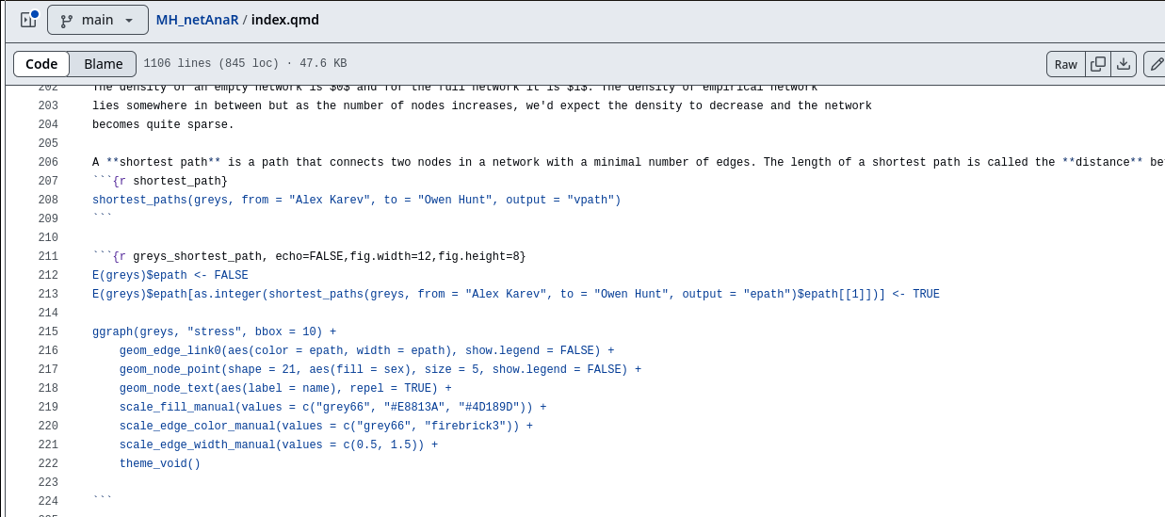
methodshub.gesis.org (debut: End of June)
https://github.com/schochastics/MH_netAnaR/blob/main/index.qmd
Notes:
Content is hosted in a Git repository, for example github. The content is written in Quarto. One can also write the content with Jupyter.

Slide 10
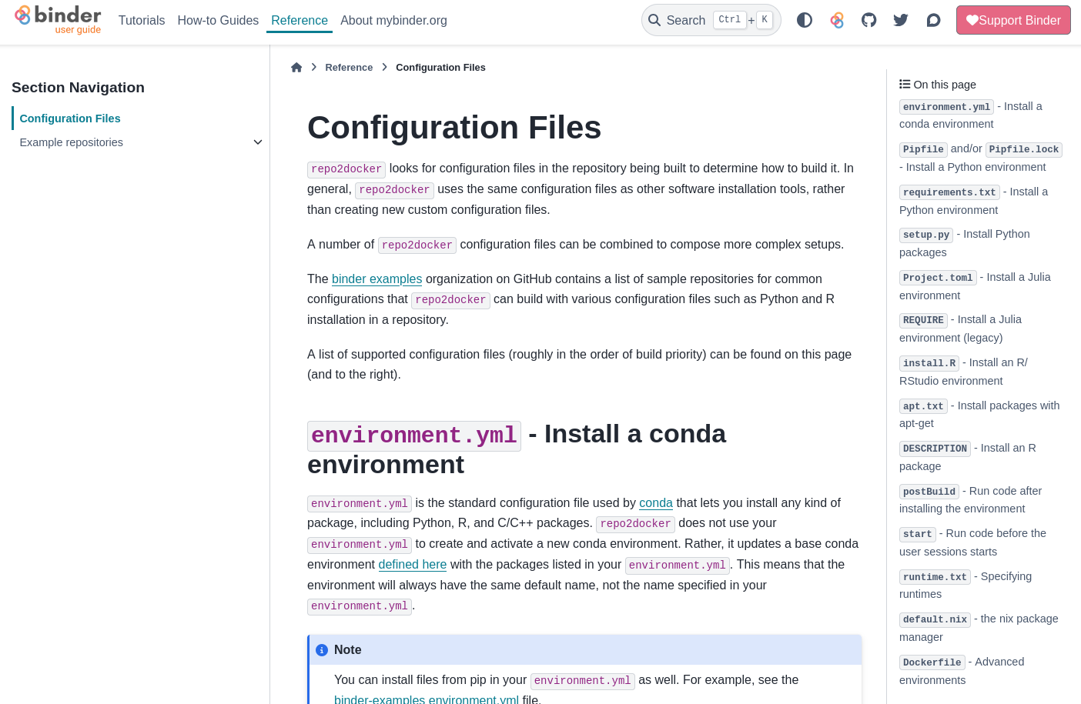
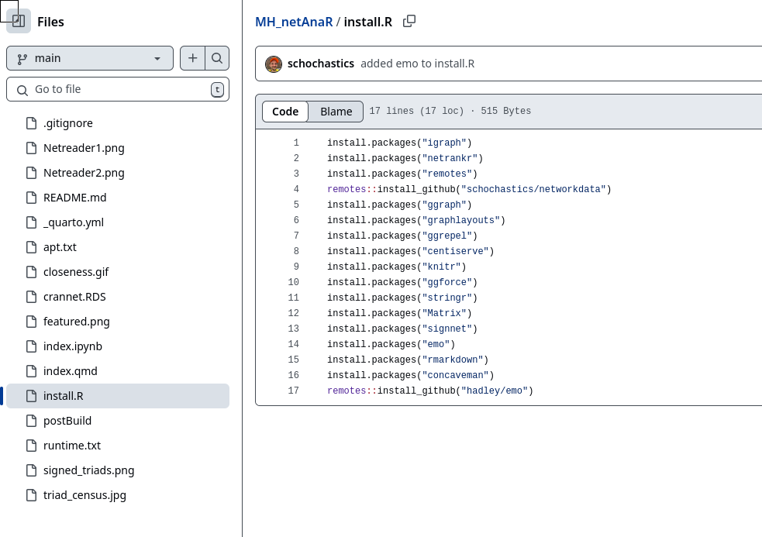
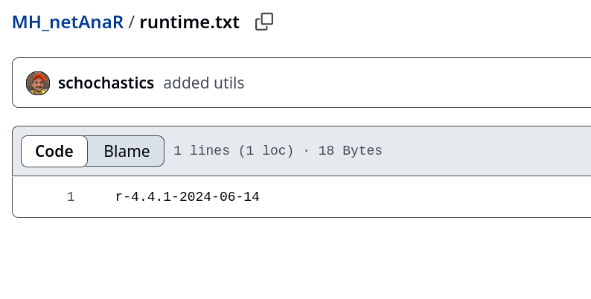





methodshub.gesis.org (debut: End of June)
https://mybinder.readthedocs.io/en/latest/using/config_files.html

Slide 11
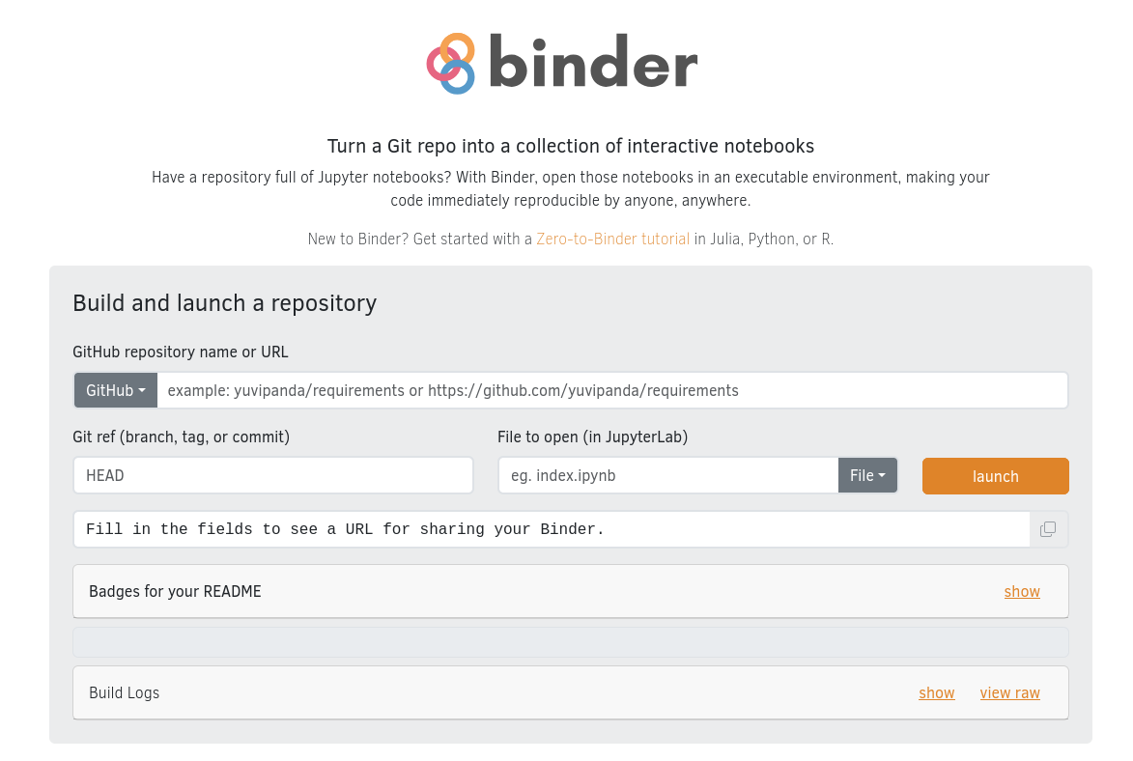
methodshub.gesis.org (debut: End of June)
https://mybinder.org/

